Slide 1


Carbon dioxide emission
prediction model
Presented by: Nankeng

Slide 2

OVERVIEW
01
02
Introduction
Data Collection and Preprocessing
03
04
Model Selection
Results and Analysis

Slide 3



INTRODUCTION
This project explores the use of machine learning to predict the CO₂ emissions of vehicles based on various features (engine power, weight, fuel consumption, etc.). It is part of an environmental sustainability initiative that aims to help policymakers and consumers better understand the environmental impact of vehicles and promote more eco-friendly choices.

Slide 4
Problem Statement
The goal is to develop a machine learning model capable of accurately predicting the CO₂ emissions of vehicles based on their technical characteristics.
Background Information
The increase in CO₂ emissions contributes to global warming. Currently, government regulations aim to limit emissions through environmental standards and carbon taxes. However, it is crucial to precisely identify the factors influencing emissions in order to drive a transition toward cleaner vehicles.

Slide 5

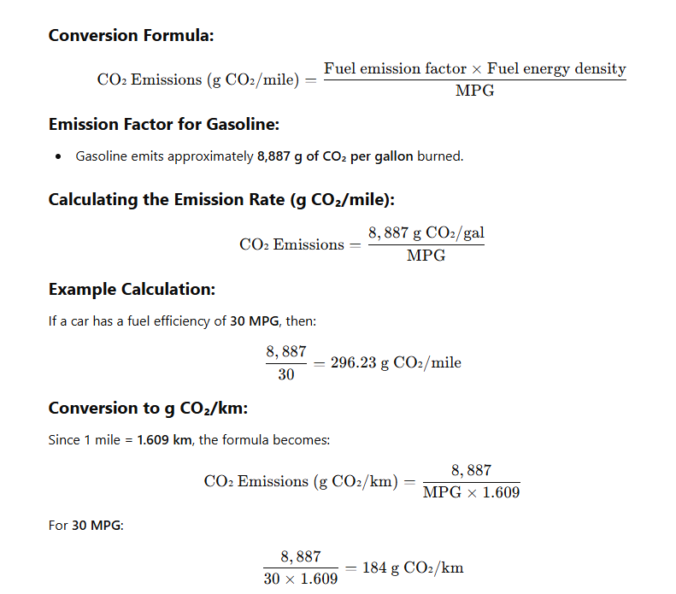

NEW DATA

Slide 6
DATA COLLECTION AND PREPROCESSING
These data points are relevant because they allow direct evaluation of factors influencing CO₂ emissions.
Dataset Description
Data Collection
Preprocessing Steps
https://raw.githubusercontent.com/murpi/wilddata/master/quests/cars.csv
Handling missing values through imputation. Detecting and removing outliers using boxplots. Normalizing the data to ensure better model convergence. Selecting the most relevant features for the model.
This dataset contains information about various vehicles, such as the number of cylinders, engine power, fuel consumption, and CO₂ emissions.

Slide 7
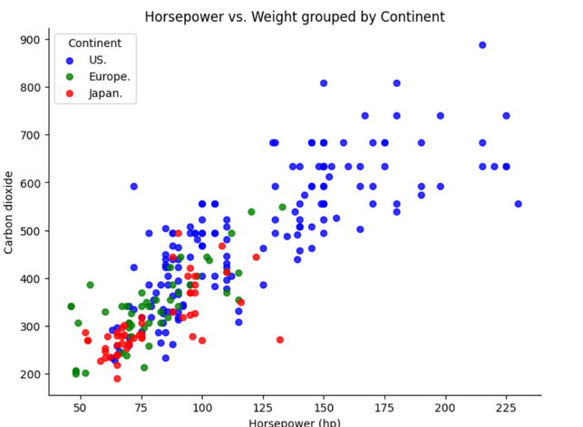
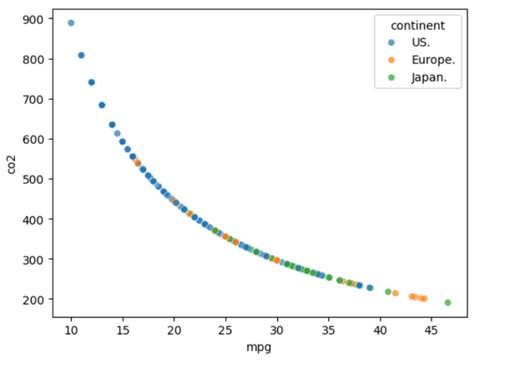
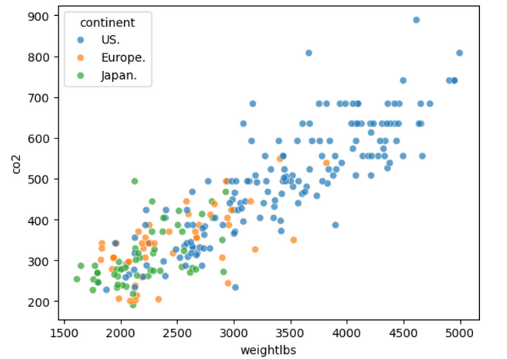
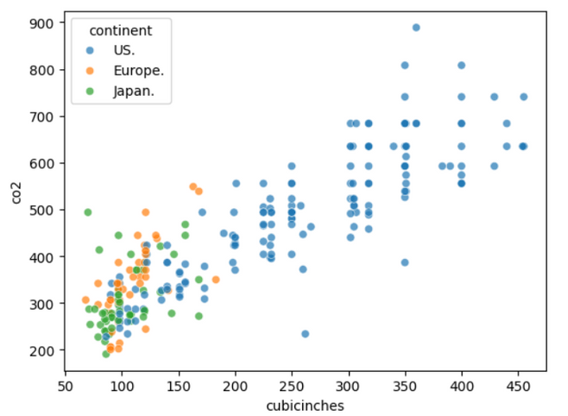
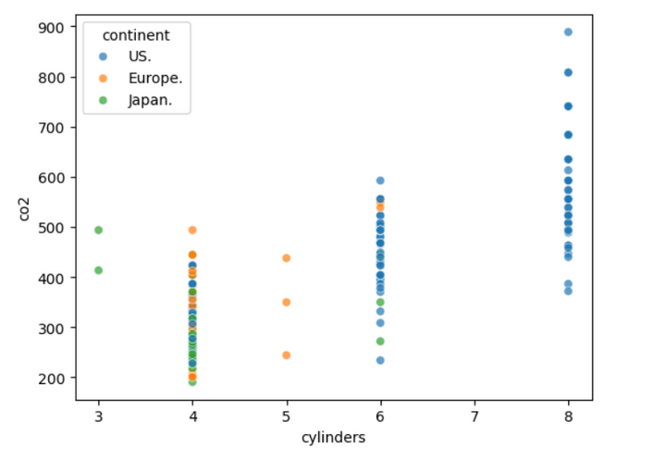
Exploratory Data Analysis

Slide 8
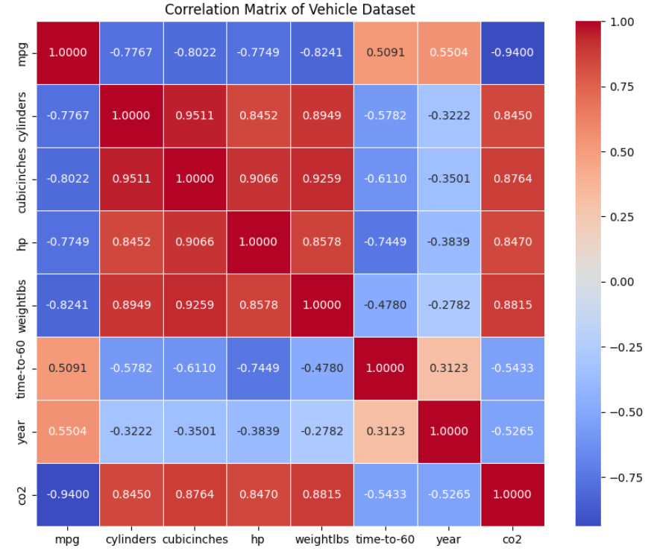
Correlation Matrix

Slide 9

Model Selection
A simple, interpretable baseline model.
Linear Regression
Random Forest
A robust model for handling non-linearities and outliers.
An advanced model designed to optimize performance.
XGBoost

Slide 10
Results and Analysis
Presentation of Results:
Comparison of models through a metrics table. Visualization of predictions with scatter plots. Interpretation of Results:
Random Forest strikes a good balance between accuracy and interpretability. XGBoost achieves the best scores in RMSE and R². Limitations and Improvements:
Incorporating real-time data. Testing deep learning models for further accuracy improvement.

Slide 11
Model Result
Model: Linear Regression
MAE: 54.7954
MSE: 4649.4618
RMSE: 68.1870
R2 Score: 0.7805
Accuracy: 0.9057
F1 Score: 0.8980
ROC AUC: 0.9046
Recall: 0.8462
Précision: 0.9565
Bias: -3.7790
Model: Random Forest
MAE: 43.4151
MSE: 3082.0651
RMSE: 55.5163
R2 Score: 0.8545
Accuracy: 0.9057
F1 Score: 0.8936
ROC AUC: 0.9038
Recall: 0.8077
Precision: 1.0000
Bias: -5.1961
Model: XGBoost
MAE: 43.6598
MSE: 3173.0610
RMSE: 56.3299
R2 Score: 0.8502
Accuracy: 0.9057
F1 Score: 0.8936
ROC AUC: 0.9038
Recall: 0.8077
Precision: 1.0000
Bias: -4.9692

Slide 12
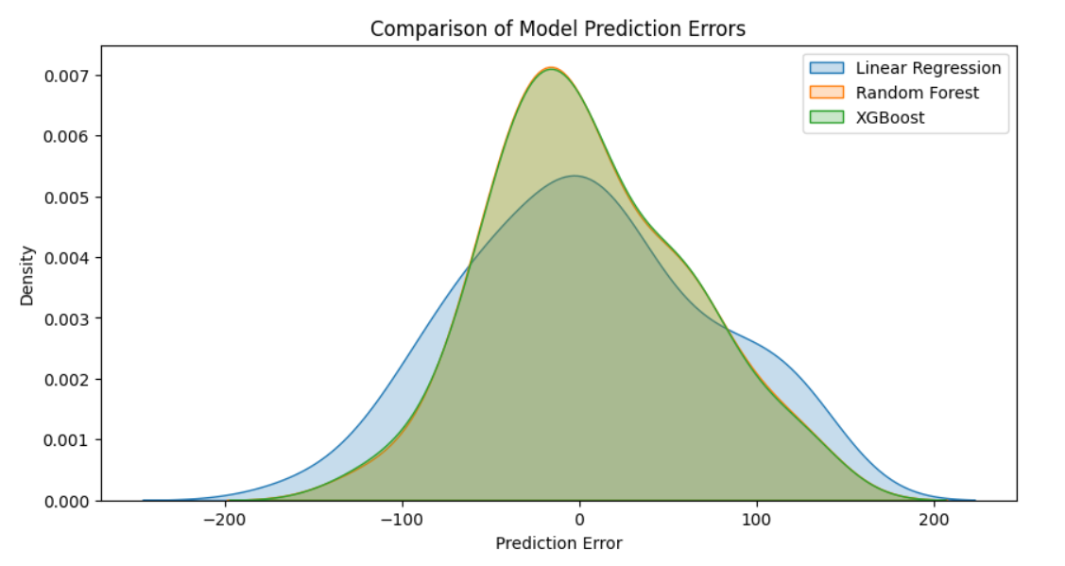

Slide 13
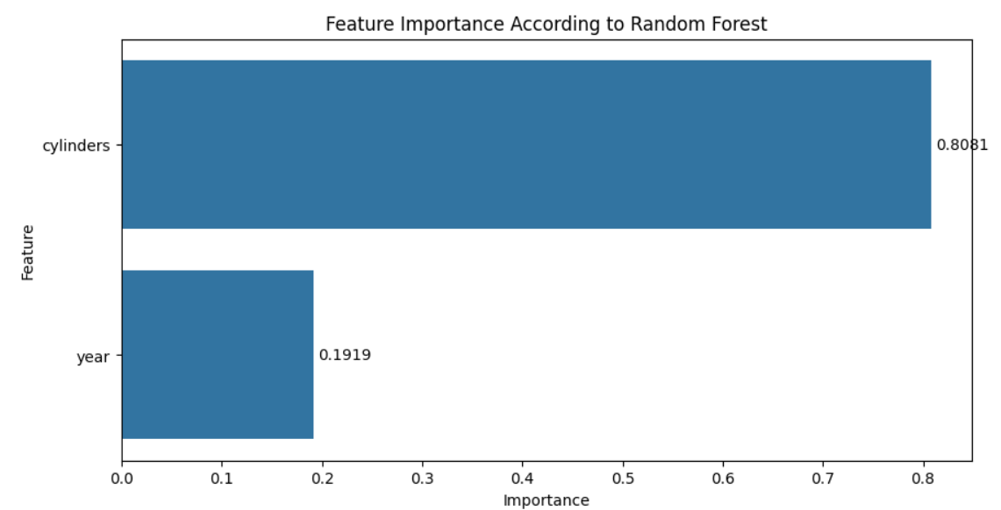
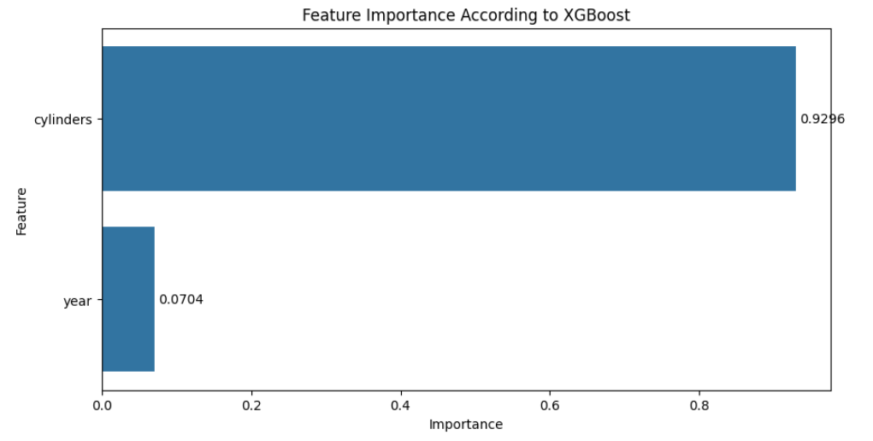

Slide 14
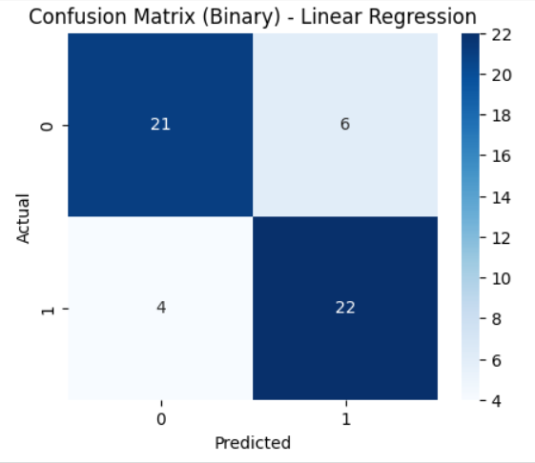
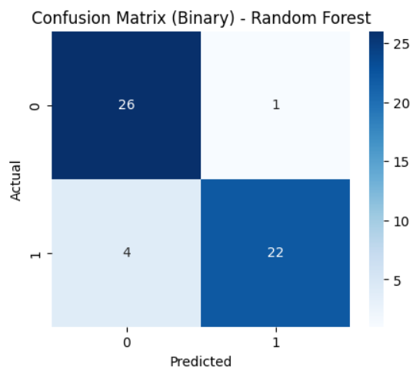
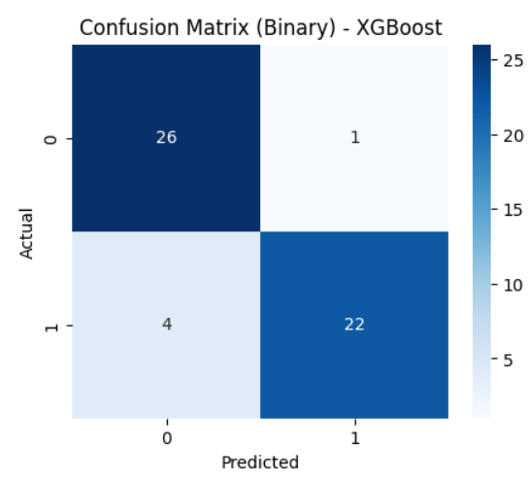

Slide 15
Conclusion
Summary of Findings: This project demonstrates that CO₂ emissions can be effectively predicted using machine learning models. Key predictors of emissions include fuel consumption and engine power.
Contribution to Green Topic: This project can help inform recommendations for eco-friendly vehicles and educate consumers on their environmental impact.
Insights and Applications: The findings can be integrated into recommendation systems for more sustainable vehicle choices.

Slide 16

Thank's For Watching

